Slide 1
Skinrender
Tom Kedik, Alaric Sheer Hardwick

Slide 2
Overview
Isometric Stealth-Puzzler
Logline:
Using stealth, and your ability to wear your victim’s skin as disguises, solve the puzzles of how to kill everyone in this 18th century inn.

Slide 3
Target Audience
Males aged 16-30
Spatial puzzles focused on learning-by-trying will suit male achievers (goals/obstacles/strategy – hard fun)
Grim setting and theme of murder and wearing skins are for a more mature audience

Slide 4
Puzzle Mechanics
Kill people in a single blow by sneaking up behind them
NPCs have a given sight ‘cone’ and will kill you if you are spotted
Can hide in pre-determined “shadow” areas so that NPCs cannot see you
Wearing the skin of someone you kill acts as a disguise for a short amount of time before the skin falls off
NPCs have set behaviours in each puzzle area or room, the player must try to find a path through a puzzle that allows them to slowly pick off each character one by one

Slide 5
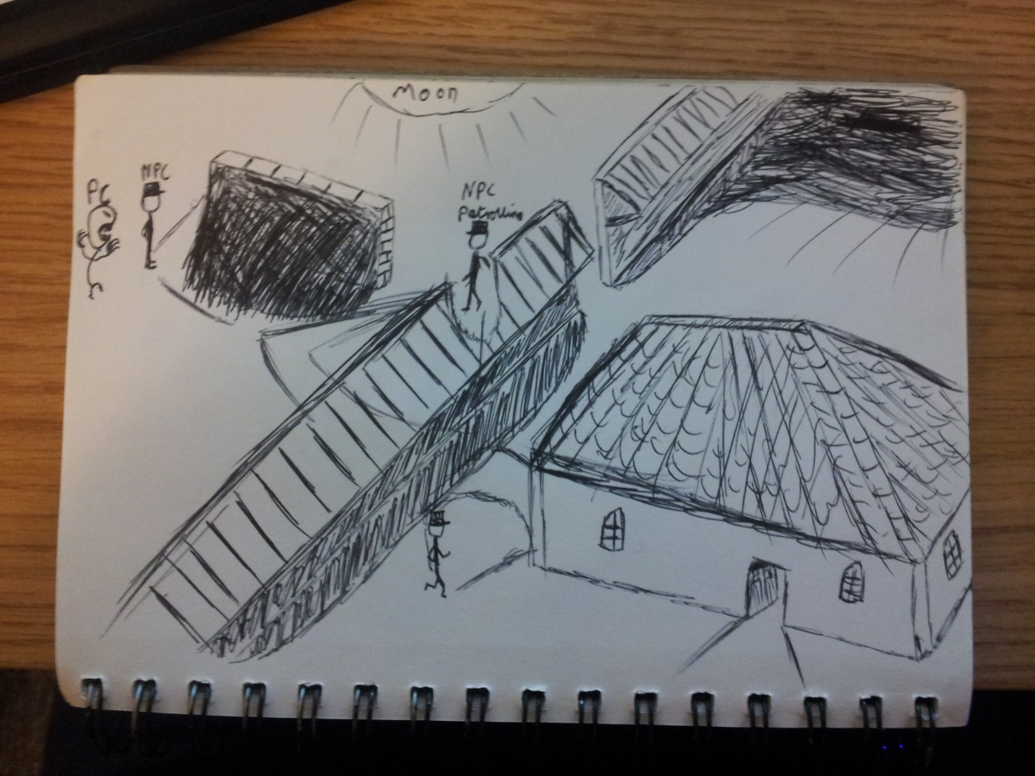
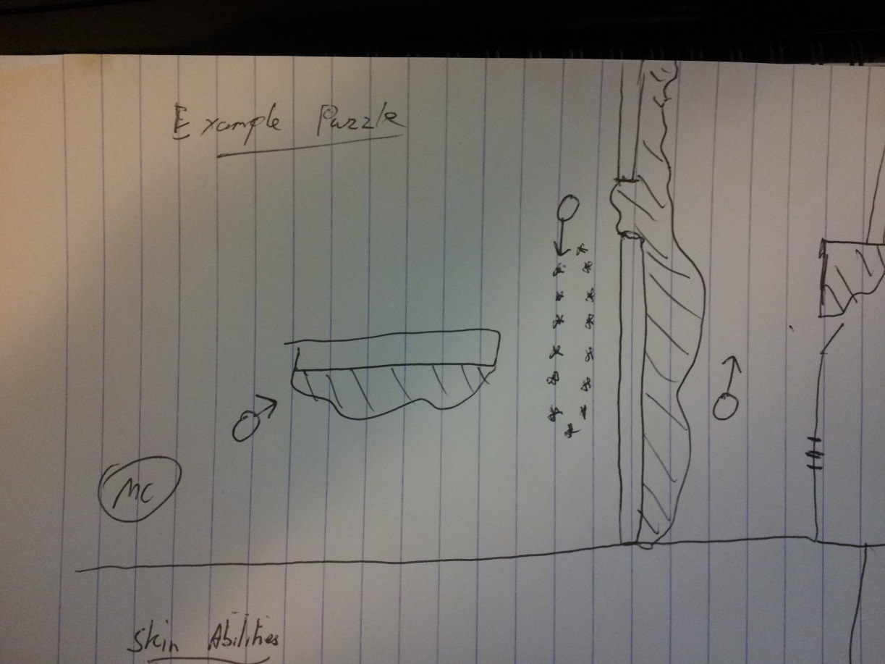
Puzzle Example 1
Note NPC movements and use stealth to kill enemies and find a safe path through to the next location

Slide 6
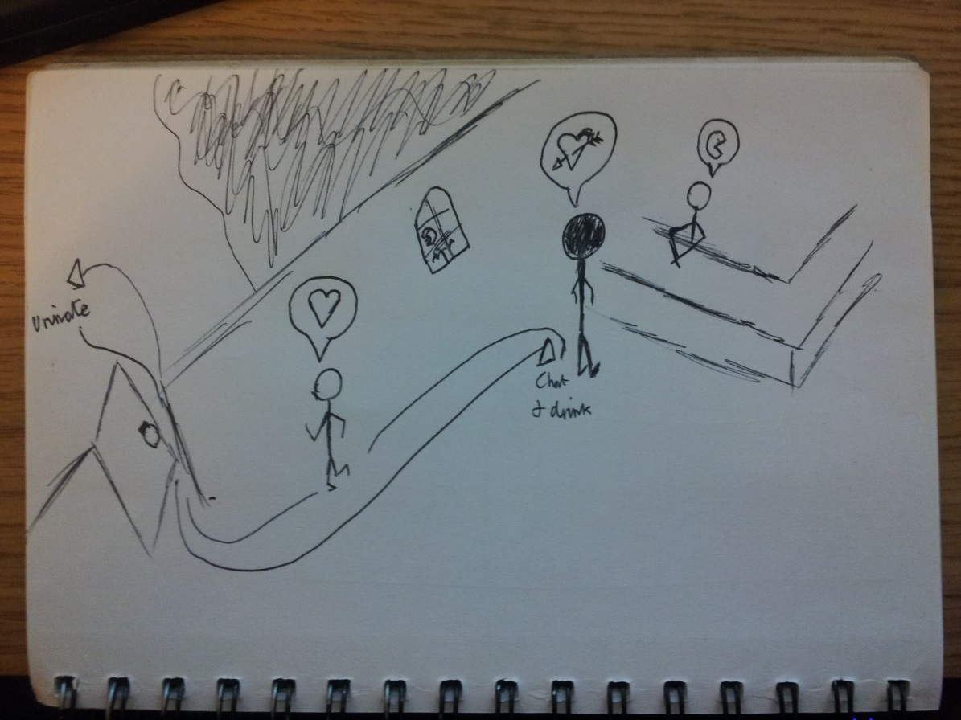
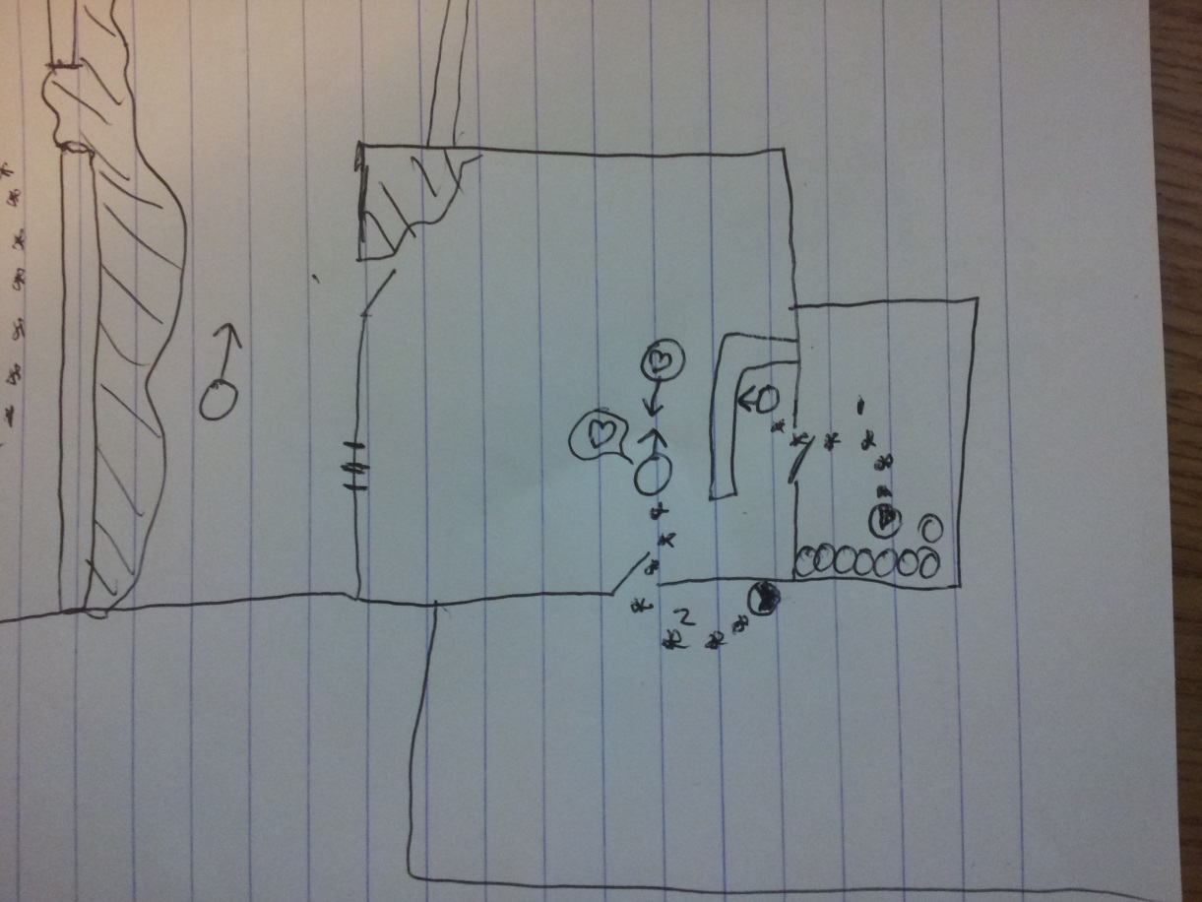
Puzzle Example 2
Stealing skin also gives temporary abilities related to the NPC’s role in the location

Slide 7
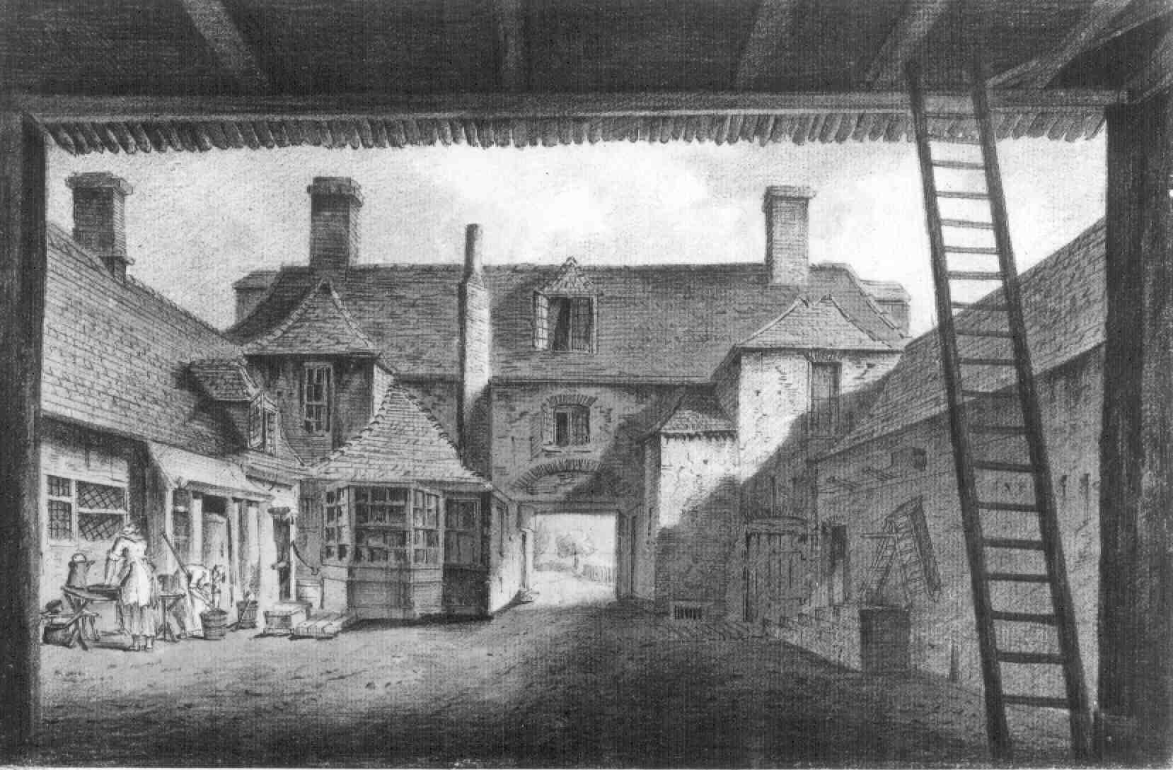
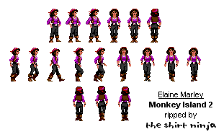
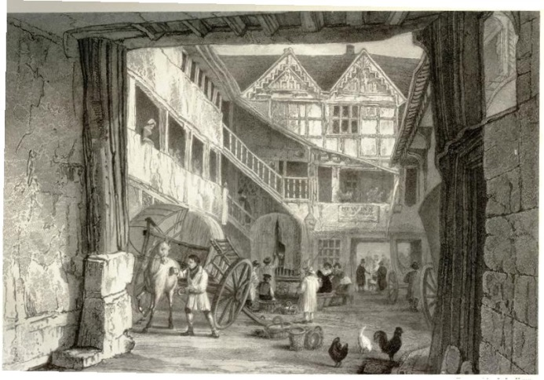
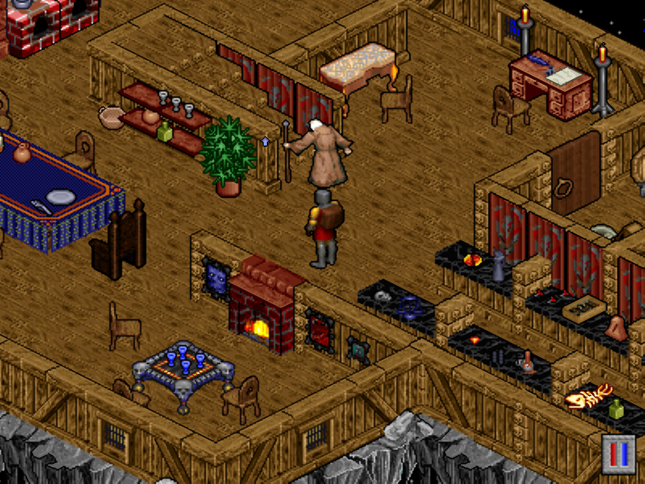
Visual Style
Architecture – 18th Century Multi-building Inn
Graphical – Isometric pixel art

Slide 8
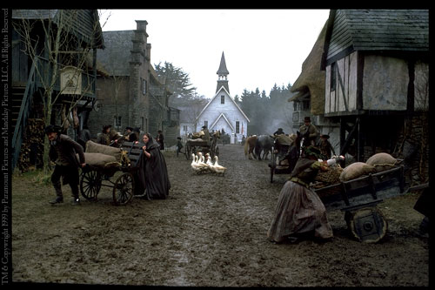
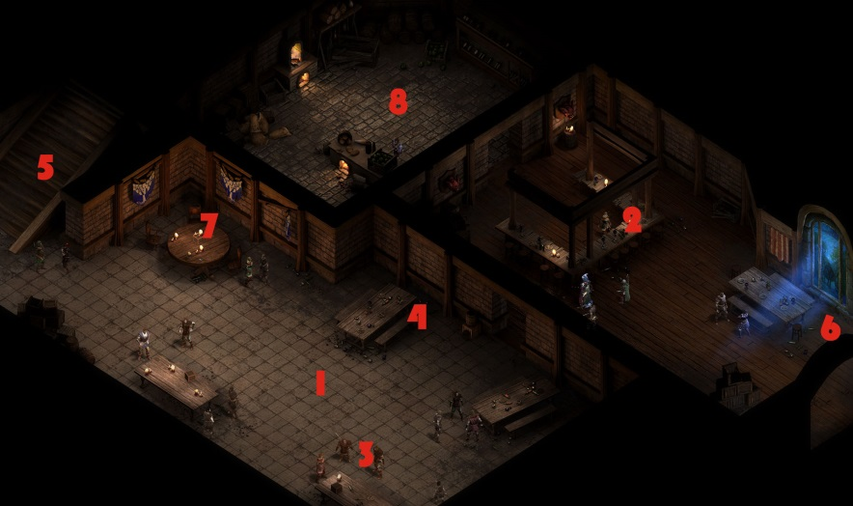
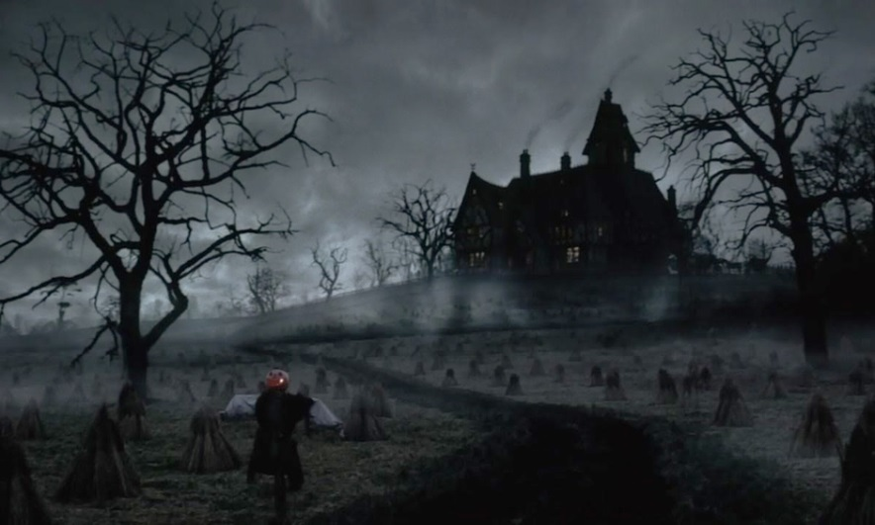
Mood References

Slide 9


Colour Palettes
Exterior - Moonlit
Interior- Candlelit

Slide 10
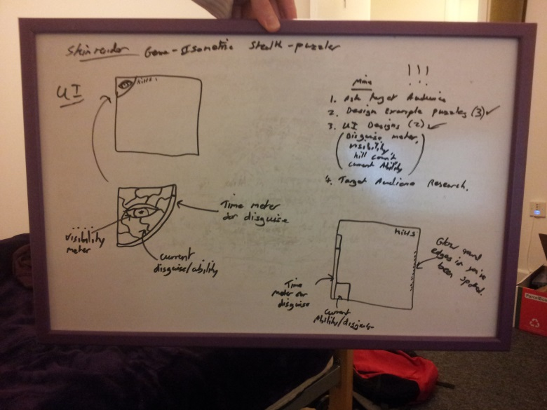
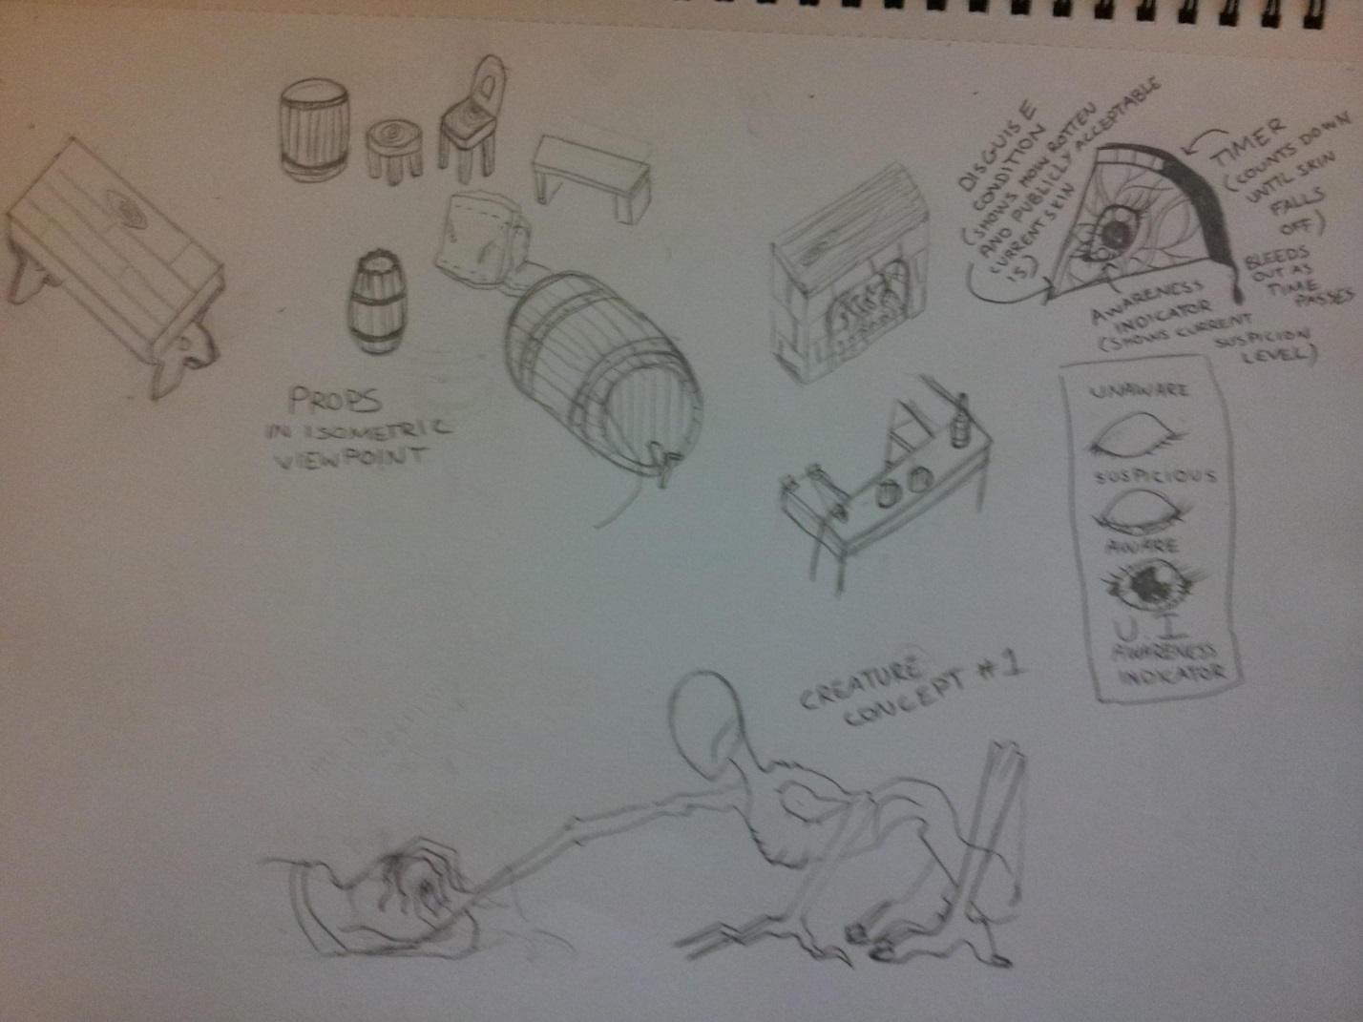
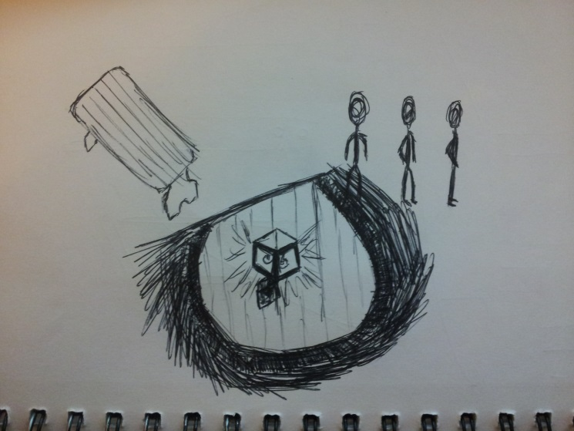
Concept Sketches

Slide 11
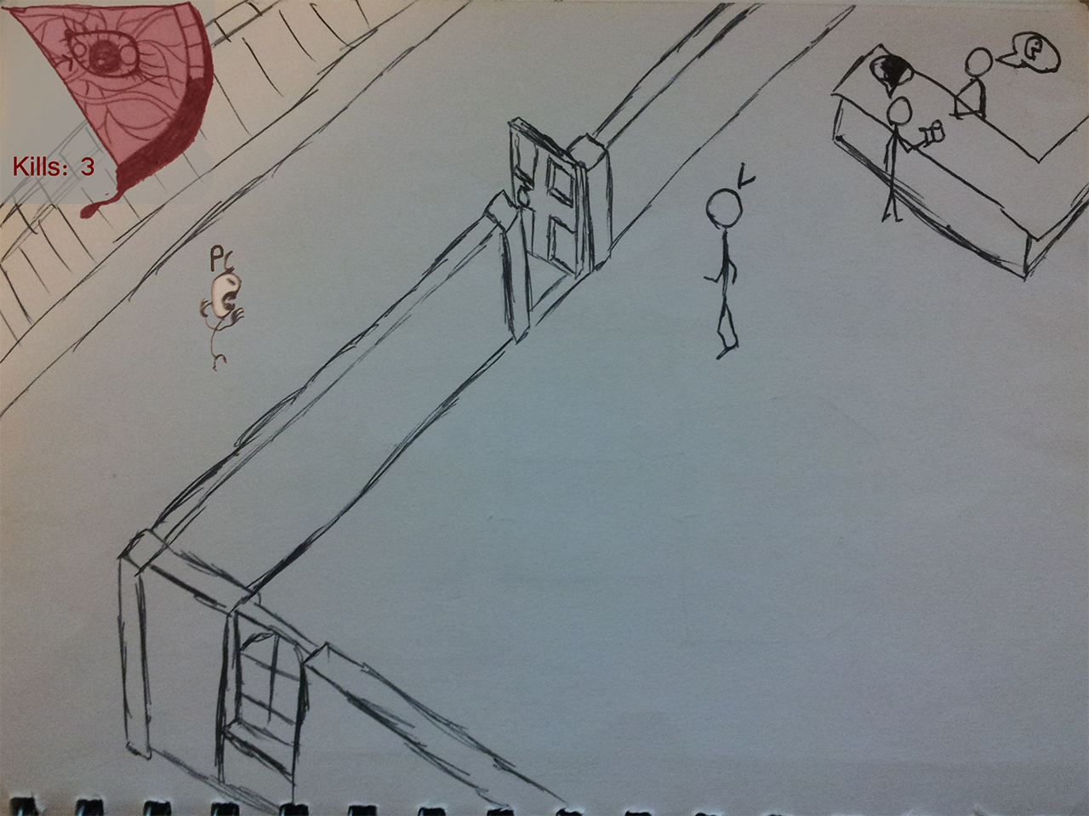
GUI Example

Slide 12
Tech Demo

Slide 13
Planned Development
20 finished puzzles (which form the game world) – selected from the best designs through iteration & playtesting
4 ‘skin’ abilities which add puzzle-solving mechanics – introduced slowly through game
Sawtooth difficulty pattern (as mechanics are introduced)
Exterior & interior isometric tilesets for the Inn (2 total)

Slide 14
Questions
What would you like to know about Skinrender?

